Slide 1


2024
SQL
Analysis
-By Shruti Shrivastava

Slide 2



Slide 3






Tables
Winners
Movies
Nominees

Slide 4


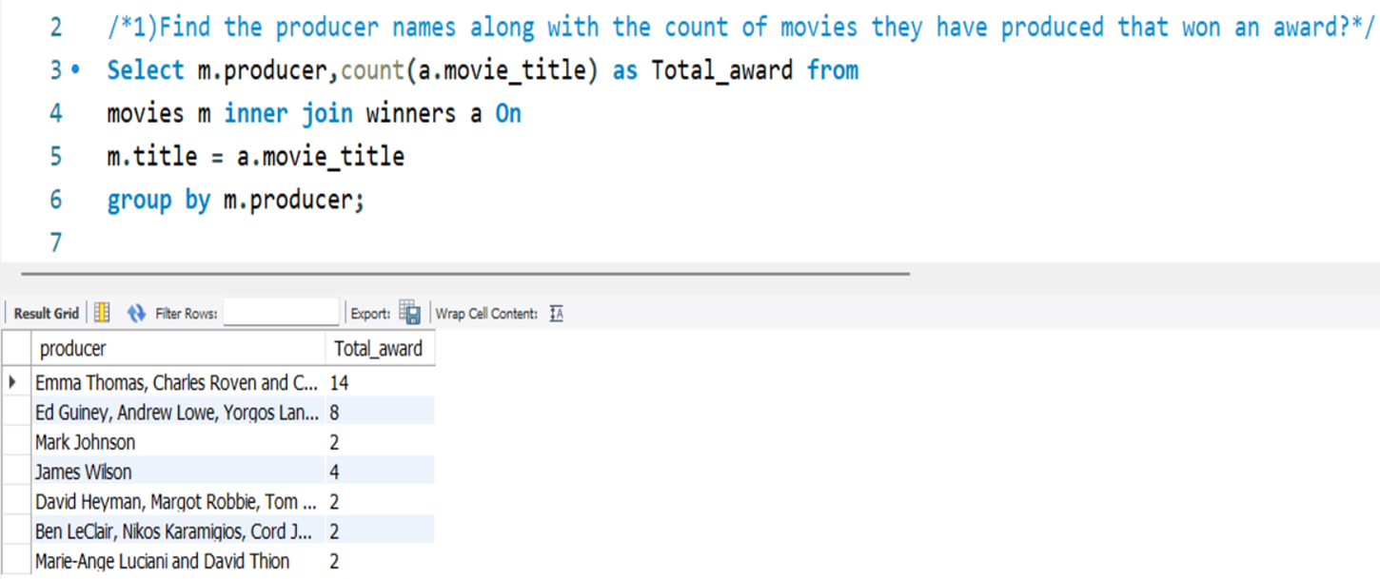

Question 1
1) Find the producer names along with the count of movies they have produced that won an award?

Slide 5


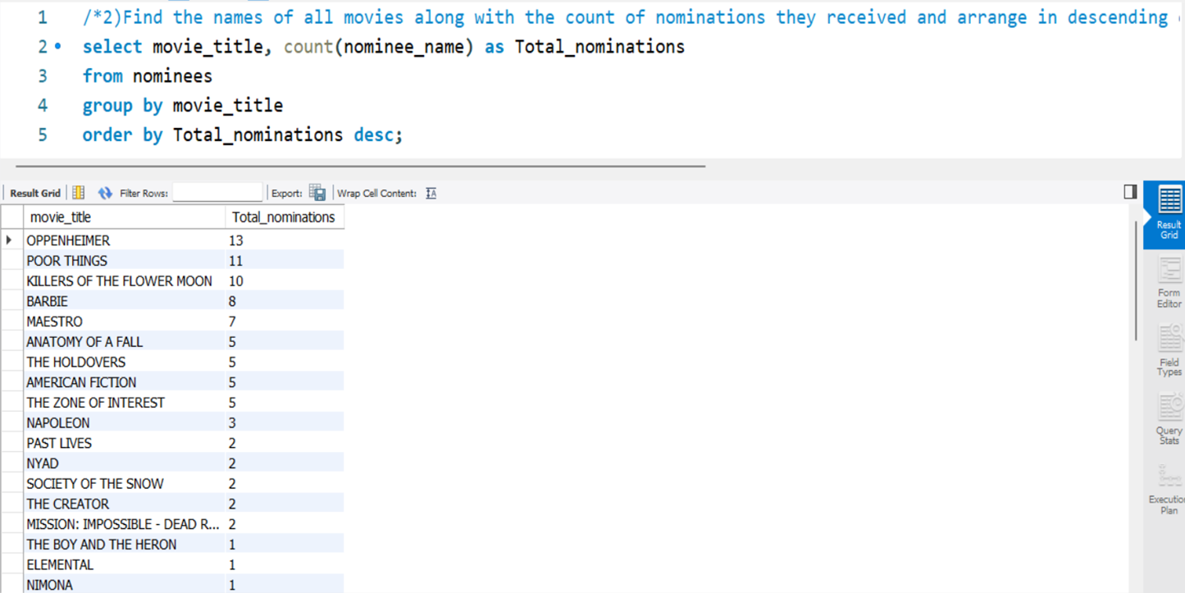
Question 2
2) Find the names of all movies along with the count of nominations they received and arrange in descending order?

Slide 6


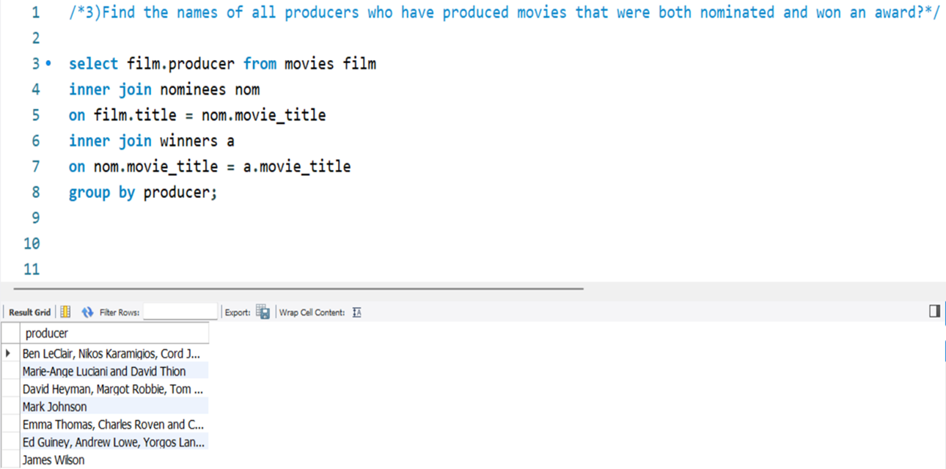
Question 3

Slide 7
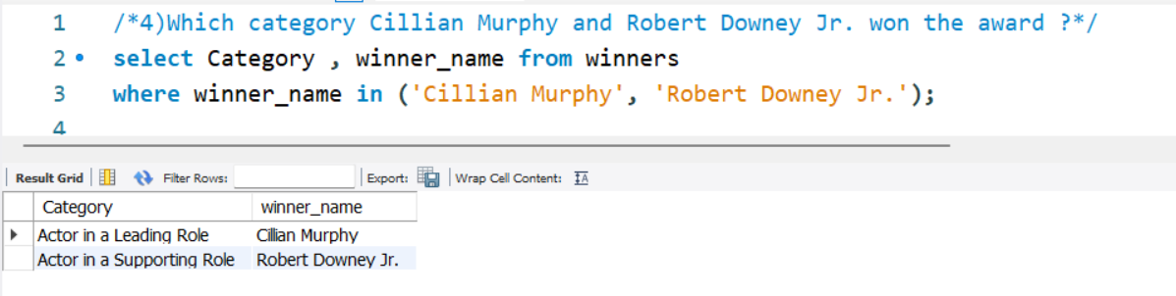
Question 4

Slide 8

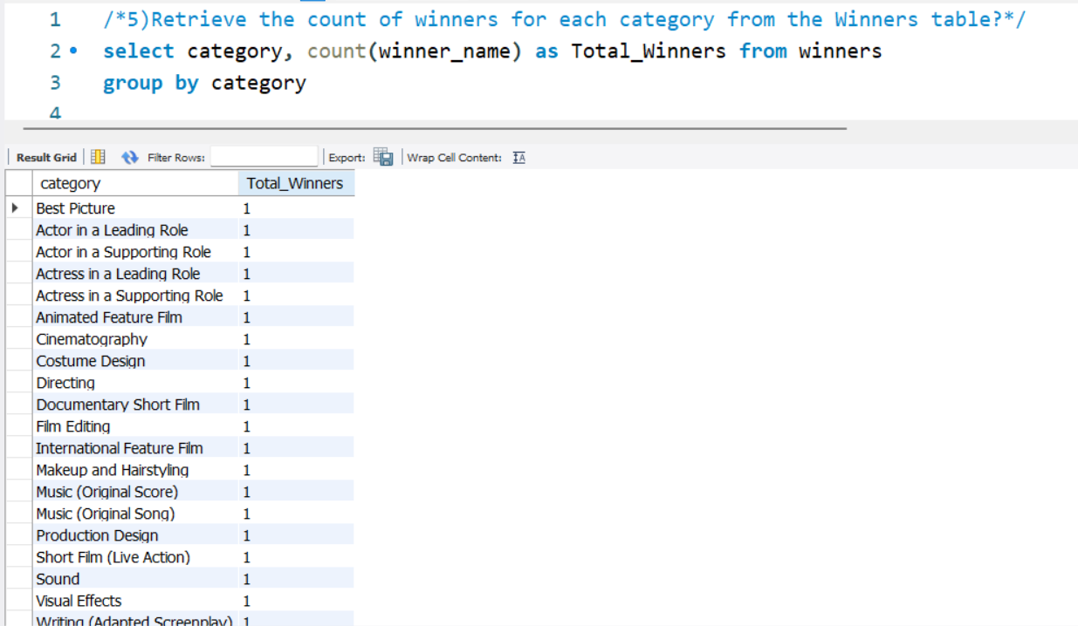
Question 5
5) Retrieve the count of winners for each category from the Winners table?

Slide 9
THANK YOU

